Slide 1
Creating variables in spreadsheet Descriptive Statistics Report Validity test Reliability test & Computing variables Dr. Peerayuth Charoensukmongkol, ICO NIDA
Research Methods in Management

Slide 2
Creating variables in spreadsheet
Variables measured on a nominal scale:
If the entity has 2 groups
Pick one category as a reference group
If a person belongs to that category,
Put 1 (one)
If a person does not belong to that category,
Put 0 (zero)
In binary language, 1 means ‘yes’; 0 means ‘no’.
Gender | Male | Female
Male | 1 | 0
Male | 1 | 0
Female | 0 | 1
Female | 0 | 1
Female | 0 | 1

Slide 3
Creating variables in spreadsheet
Variables measured on a nominal scale:
If the entity has more than 2 groups,
Create a variable for each group
If a person belongs to that category,
Put 1 (one)
If a person does not belong to that category,
Put 0 (zero)
Marital status | Single | Married | Divorce
Single | 1 | 0 | 0
Single | 1 | 0 | 0
Single | 1 | 0 | 0
Married | 0 | 1 | 0
Married | 0 | 1 | 0
Divorce | 0 | 0 | 1
Divorce | 0 | 0 | 1

Slide 4
Creating variables in spreadsheet
Variables measured on a ordinal scale:
Assign the number to each category based on its rank.
The group that is ranked the lowest get the smallest number
The group that is ranked the highest get the biggest number.
Education | Value
Below Bachelor’s degree | 1
Bachelor’s degree: | 2
Master’s degree: | 3
Doctoral degree: | 4

Slide 5
Creating variables in spreadsheet
Variables measured on a Ratio/Interval scale:
Key in their actual values
Person | Age (in years)
1 | 32
2 | 22
3 | 54
4 | 21

Slide 6
Report descriptive statistics
If the variable is measured using “ratio scale” (fill in a real number), report: Mean and Standard deviation
If the variable is measured using “nominal scale” or “ordinal scale”, (grouping categories, ranges of numbers, , or choices) report: Frequency and Percentage

Slide 7
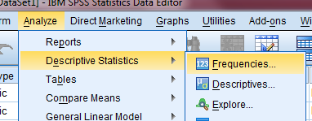
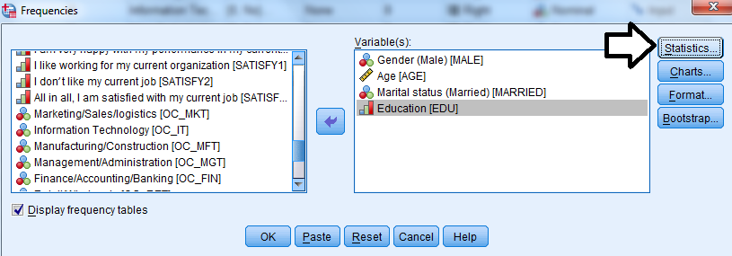
Report descriptive statistics

Slide 8
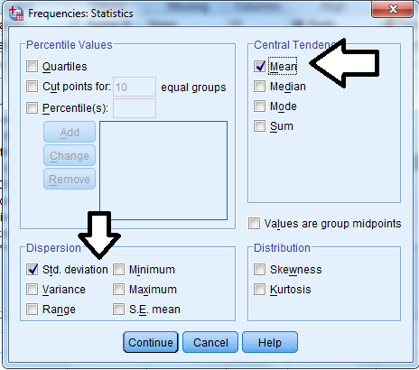
Report descriptive statistics

Slide 9
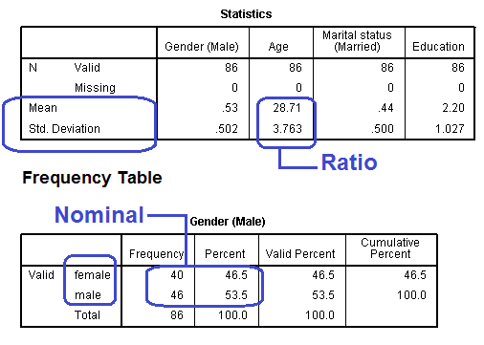
Report descriptive statistics

Slide 10
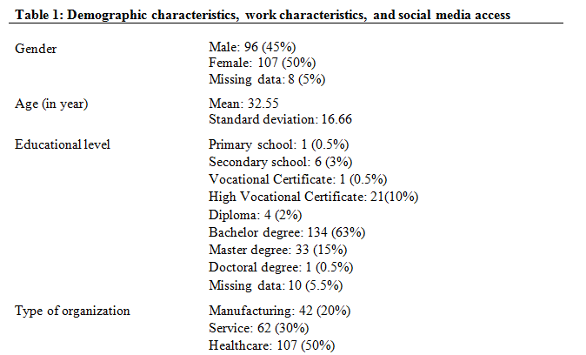
Report descriptive statistics

Slide 11
Validity test using Exploratory Factor Analysis (EFA)
EFA is a statistical method used to uncover the underlying structure of a relatively large set of variables.
EFA is used to:
Reduces a large number of variables into a smaller set of variables (also referred to as factors).
Establishes underlying dimensions between measured variables and latent constructs, thereby allowing the formation and refinement of theory.
Provides construct validity evidence of self-reporting scales.

Slide 12
Validity test using Exploratory Factor Analysis (EFA)
Given that there are 9 animals, how many categories you can put them in?
Exploratory factor analysis will detect some patterns
and tell us that these 9 animals can be grouped into how many categories

Slide 13
Validity test using Exploratory Factor Analysis (EFA)
Performing the exploratory factor analysis

Slide 14
 | Category 1 | Category 2 | Category 3
 | 0.87 | 0.23 | 0.21
 | 0.89 | 0.11 | 0.14
 | 0.94 | 0.21 | 0.26
 | 0.21 | 0.89 | 0.17
 | 0.14 | 0.87 | 0.10
 | 0.26 | 0.84 | 0.07
 | 0.21 | 0.91 | 0.12
 | 0.06 | 0.12 | 0.79
 | 0.08 | 0.22 | 0.81
Cats Dogs Hamster
These 3 animals have
high percentage of
belonging to
Category 1 than
other categories
(0.87, 0.89, 0.94)
These 4 animals have
high percentage of
belonging to
Category 2 than
other categories
(0.89, 0.87, 0.84, 0.91)
These 2 animals have
high percentage of
belonging to
Category 3 than
other categories
(0.79, 0.81)

Slide 15
Validity test using Exploratory Factor Analysis (EFA)
Given that there are 6 animals, how many categories you can put them in?
Exploratory factor analysis will detect some patterns
and tell us that these 6 animals can be grouped into how many categories

Slide 16
Validity test using Exploratory Factor Analysis (EFA)
Performing the exploratory factor analysis

Slide 17
 | Category 1 | Category 2
 | 0.78 | 0.27
 | 0.77 | 0.31
 | 0.73 | 0.26
 | 0.71 | 0.21
 | 0.37 | 0.69
 | 0.24 | 0.77
Cats Tigers
EFA does not see that this
entity can be grouped into
the category that we expect
it to belong to.
Sometime the entity may be
removed to maintain the
validity of the construct.

Slide 18
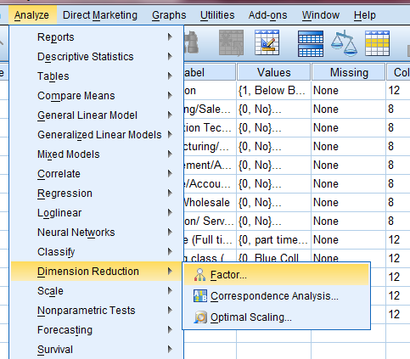
Validity test using Exploratory Factor Analysis (EFA)

Slide 19
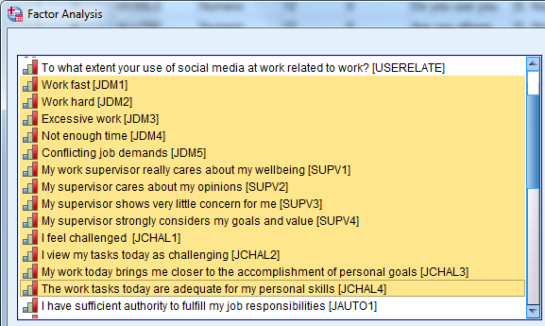
Validity test using Exploratory Factor Analysis (EFA)
Job demands
Supervisor support
Job challenge
Insert all questions that measure these 3 concepts

Slide 20
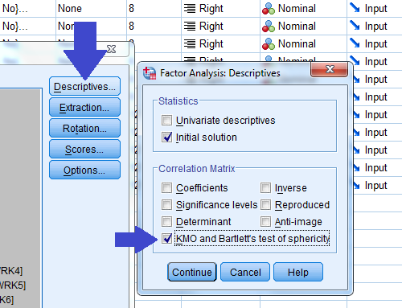
Validity test using Exploratory Factor Analysis (EFA)

Slide 21
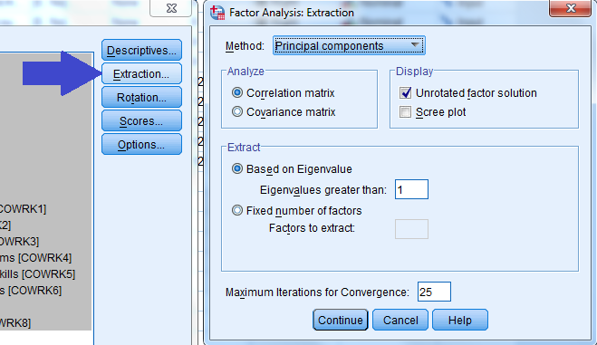
Validity test using Exploratory Factor Analysis (EFA)
Based on Eigenvalue: The software will determine how many factors you have based on the data
Fixed number of factors:
You specify how many factors you have in the data

Slide 22
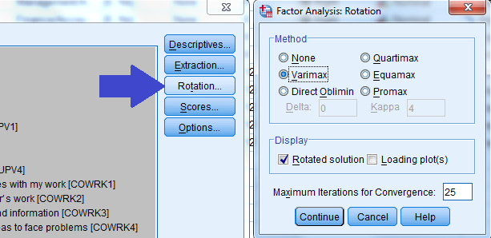
Validity test using Exploratory Factor Analysis (EFA)

Slide 23
Validity test using Exploratory Factor Analysis (EFA)
Good if > 0.7
Good if < 0.05
Caution:
These results are not enough to proof validity!!!
The quality of scale validity have to be proven in the next step.

Slide 24
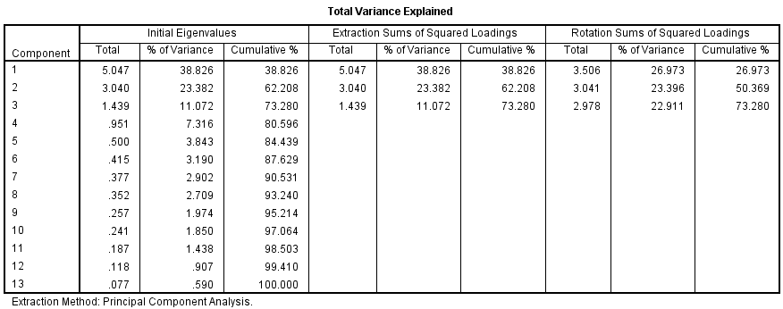
Validity test using Exploratory Factor Analysis (EFA)
This indicates that the question items can be grouped into 3 factors
Factor 1 explains 38.826% of total variance
Factor 2 explains 23.382% of total variance
Factor 3 explains 11.072% of total variance

Slide 25
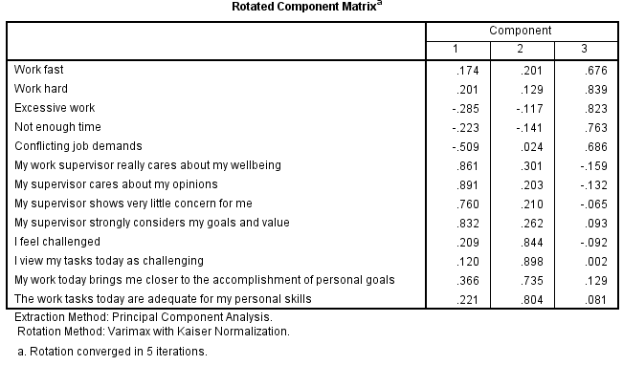
Validity test using Exploratory Factor Analysis (EFA)
Question items that belong to the same concept are grouped correctly under the same category. This is called a good “convergent validity”

Slide 26
Reliability test using Cronbach's alpha (α)
Cronbach's alpha determines the internal consistency or average correlation of items in a survey instrument to gauge its reliability;.

Slide 27
Reliability test: Cronbach's alpha (α)
Nunnally (1967) recommended the minimum value of 0.7
Cronbach's alpha | Internal consistency
α ≥ 0.9 | Excellent
0.7 ≤ α < 0.9 | Good
0.6 ≤ α < 0.7 | Acceptable
0.5 ≤ α < 0.6 | Poor
α < 0.5 | Unacceptable
Nunnally, J.C. (1967). Psychometric Theory. New York, NY: McGraw-Hill

Slide 28
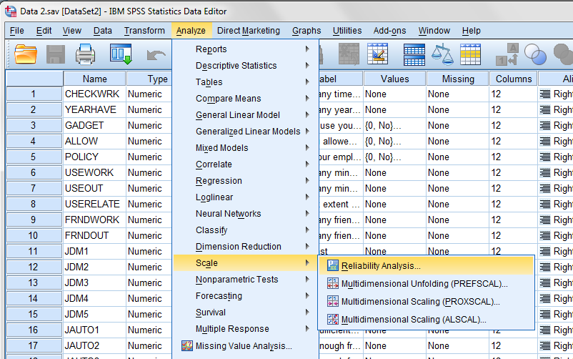
Reliability

Slide 29
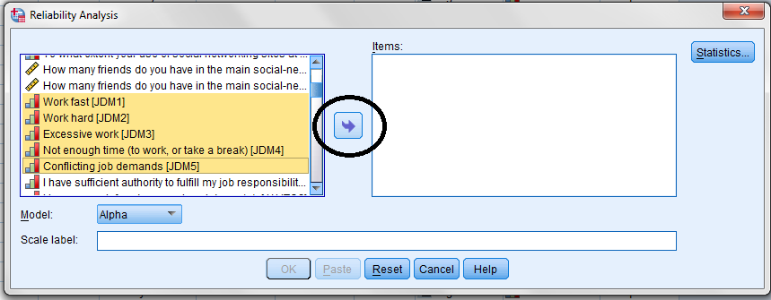

Slide 31
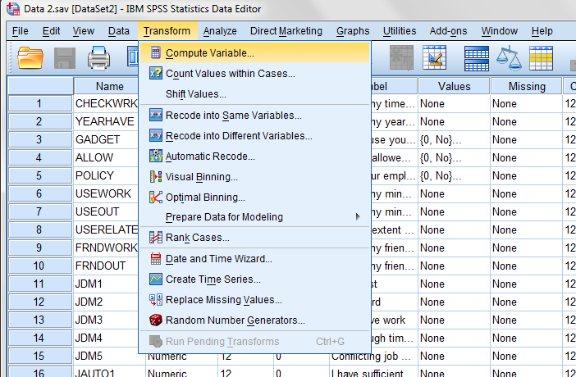
Compute variables

Slide 32
Compute summated score
…or Average score

Slide 33
Hypothesis testing
Research Methods in Management

Slide 34
Hypothesis testing
Hypothesis testing or significance testing is a systematic way to test claims or ideas about a group or population, using data measured in a sample.
Two types of statistical testing that are covered in the class
Means comparison
Relationship analysis

Slide 35
Hypothesis testing
The method of hypothesis testing can be summarized in two steps.
State the hypotheses
Compute the test statistic and make a decision

Slide 36
Step 1: State the hypotheses.
Null hypothesis (H0)
Alternative hypothesis (Ha)
H0 and Ha is opposite to each other
If H0 = true, Ha=false
If H0 = equal, Ha = unequal

Slide 37
Step 1: State the hypotheses.
Mathematical Symbols
Null hypothesis always expresses an ‘equal sign’ (=).
Alternative hypothesis is the opposite to the null hypothesis.
Null hypothesis (H0)
= , ≤, ≥
Alternative hypothesis (Ha)
≠ , > ,<
If H0 suggests that X=0, Ha suggests that X ≠ 0
If H0 suggests that X ≤ 0, Ha suggests that X > 0
If H0 suggests that X ≥ 0, Ha suggests that X < 0

Slide 38
Step 1: State the hypotheses.
Null hypothesis (H0)
Means comparison
Mean of A = Mean of B
Relationship analysis
Relationship between A and B = 0
Alternative hypothesis (Ha)
Means comparison
Means of A ≠ Mean of B
Relationship analysis
Relationship between A and B ≠ 0

Slide 39
Step 1: State the hypotheses.
The Null hypothesis (H0) reflects that there will be no observed effect for our experiment.
The null hypothesis is what we are attempting to overturn by our hypothesis test.
The only reason we are testing the null hypothesis is because we think it is wrong.

Slide 40
Step 1: State the hypotheses.
Example:
Means comparison
Average salary of Male = Average salary of Female
Relationship analysis
The relationship between age and income = 0

Slide 41
Step 1: State the hypotheses.
We state what we think is wrong about the null hypothesis in an Alternative hypothesis (Ha).
An alternative hypothesis is a statement that directly contradicts a null hypothesis

Slide 42
Step 1: State the hypotheses.
Example: Means comparison
Does Males and Females earn the same level of salary?
Null hypothesis:
Average salary of Male = Average Salary of Female
Alternative hypothesis:
Average Salary of Male ≠ Average Salary of Female
Average Salary of Male > Average Salary of Female
Average Salary of Male < Average Salary of Female

Slide 43
Step 1: State the hypotheses.
Example: Relationship analysis
The relationship between age and income
Null hypothesis:
The relationship between age and income = 0
Alternative hypothesis:
The relationship between age and income ≠ 0
The relationship between age and income > 0 (Positive relationship)
The relationship between age and income < 0
(Negative relationship)

Slide 44
Step 1: State the hypotheses.
One-tailed test VS Two-tailed test
One-tailed test
Average Salary of Male > Average Salary of Female
“OR”
Average Salary of Male < Average Salary of Female
Two-tailed test
Average Salary of Male > Average Salary of Female
“AND”
Average Salary of Male < Average Salary of Female

Slide 45
Step 2: Make a decision from statistical analysis
The test statistic is a mathematical formula that allows researchers to determine the likelihood of obtaining sample outcomes if the null hypothesis were true.
For example: t-statistics, F-statistics
The value of the test statistic is used to make a decision regarding the null hypothesis.

Slide 46
Step 2: Make a decision from statistical analysis .
To set the criteria for a decision, we state the level of significance for a test
.
Level of significance, or significance level, refers to a criterion of judgment upon which a decision is made regarding the value stated in a null hypothesis.
The criterion is based on the probability of obtaining a statistic measured in a sample if the value stated in the null hypothesis were true.
In behavioral science, the criterion or level of significance is typically set at 5% (0.05)

Slide 47
Step 2: Make a decision from statistical analysis
A p-value is the probability of obtaining a sample outcome, given that the value stated in the null hypothesis is true.
We reject the null hypothesis when the p value is less than 5% (p < 0.05)
If the null hypothesis is rejected (p < 0.05), then the alternative hypothesis is true.
If we fail to reject the null hypothesis is (p>0.05), then the alternative hypothesis is false.

Slide 48
Step 2: Make a decision from statistical analysis
H₀: Average salary _{Male} = Average salary _{Female}
H_{a}: Average salary _{Male} ≠ Average salary _{Female}
If p-value = 0.02, then
Reject H₀
Conclusion
Average salary _{Male} ≠ Average salary _{Female}

Slide 49
Step 2: Make a decision from statistical analysis
H₀: Average salary _{Male} = Average salary _{Female}
H_{a}: Average salary _{Male} ≠ Average salary _{Female}
If p-value = 0.63, then
Fail to reject H₀
Conclusion
Average salary _{Male} = Average salary _{Female}

Slide 50
Step 2: Make a decision from statistical analysis
P-value | Level of statistical significant that can reject null hypothesis
.01 < p-value ≤ .05 | Significant at the 5 percent level | Sufficient *
.001 < p-value ≤ .01 | Significant at the 1 percent level | Strong **
p-value ≤ .001 | Significant at the .1 percent level | Strongest ***

Slide 51
Step 2: Make a decision from statistical analysis
Type I Error (False positive).
Your reject the null hypothesis when it is true in reality.
Just because a other people judge that a person is “guilty“ does not mean that a person is actually guilty in reality.
Type II Error (False negative).
You fail to reject the null hypothesis when it is false in reality.
Just because a other people judge that a person is “innocent“ does not mean that a person is actually innocent in reality.

Slide 52
Means comparison techniques
T-Test
One way analysis of variance (ANOVA)

Slide 53
Independent Samples “T-test”
The Independent Samples t-test can be used to see if two means are different from each other when the two samples that the means are based on were taken from different individuals who have not been matched.

Slide 54
Independent Samples “T-test”
Null hypothesis (H0):
Mean Salary of Male = Mean Salary of Female
Alternative hypothesis (Ha):
Mean Salary of Male ≠ Mean Salary of Female
Mean Salary of Male > Mean Salary of Female
Mean Salary of Male < Mean Salary of Female
If the p-value from the T-test is <0.05, then
Reject H0 (Means of salary of Male vs Female are different)
If the p-value from the T-test is >0.05, then
Fail to reject H0 (Means are not different)

Slide 55
Independent Samples “T-test”
The t-test assumes that “the variability of each group is approximately equal”.
"Levene's Test for Equality of Variances" tell us whether an assumption of the t-test has been met.
Null hypothesis (H0): The variability of the two groups is equal (Variance _{Group A}= Variance _{Group B})
Alternative hypothesis (Ha): The variability of the two groups is unequal (Variance _{Group A} ≠ Variance _{Group B})
The p-value of the Levene's Test should be >0.05 to satisfy the Levene's Test for Equality of Variances

Slide 56
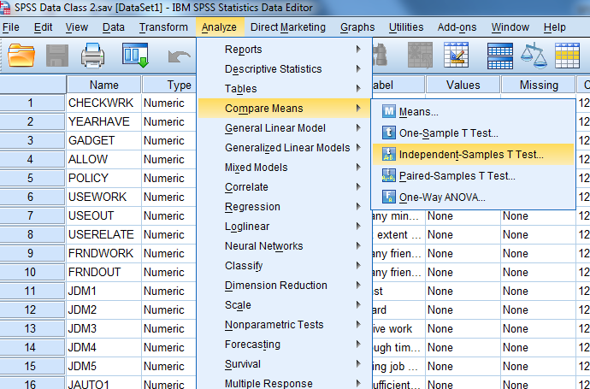
Independent Samples “T-test”

Slide 57
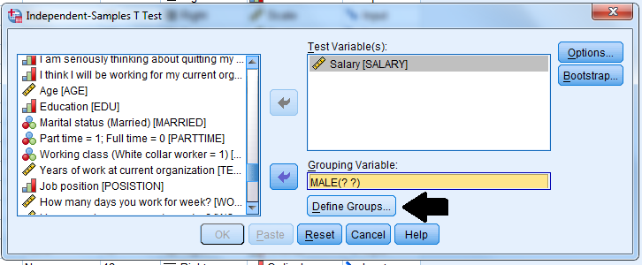
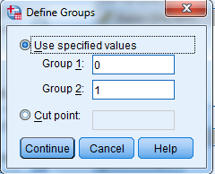
Independent Samples “T-test”
We earlier set Male = 1 and Female = 0

Slide 58
Independent Samples “T-test”
Significant level of the Levene’s test
If it is > than 0.05, use the results
from the row “Equal variances assumed”
If it is < 0.05, use the results
from the row “Equal variances not assumed”
Significant level of the t-test
P-value < 0.05: means difference is statistically significant.
P-value > 0.05: means difference is NOT statistically significant.
Conclusion: Although males earned more salary than female by 10,206 THB, this mean difference is NOT statistically supported.
This result can’t be confirmed by significant testing

Slide 59
One way analysis of variance (ANOVA)
The one way analysis of variance (ANOVA) is an inferential statistical test that allows you to test if any of several means are different from each other.
ANOVA is used when you want to compare means among 3 or more groups.

Slide 60
One way analysis of variance (ANOVA)
The ANOVA assumes that “the variability of each group is approximately equal”.
"Test of Homogeneity of Variances" tell us whether an assumption of the ANOVA has been met.
Null hypothesis (H0): The variances are equal
(Variance _{Group A}= Variance _{Group B} = Variance _{Group C})
Alternative hypothesis (Ha): The variances are unequal (Variance _{Group A}≠ Variance _{Group B} ≠ Variance _{Group C})
The p-value of the Test of Homogeneity of Variances should be >0.05 to satisfy the requirement.

Slide 61
One way analysis of variance (ANOVA)
F-statistics
F-statistics is used to determine if all the means are equal.
H0: Mean _{Group A} = Mean _{Group B=}Mean _{Group C}
Ha: Mean _{Group A} ≠ Mean _{Group B} ≠ Mean _{Group C}
If the p-value is less than 0.05, then you can reject H₀ that all the means are equal.

Slide 62
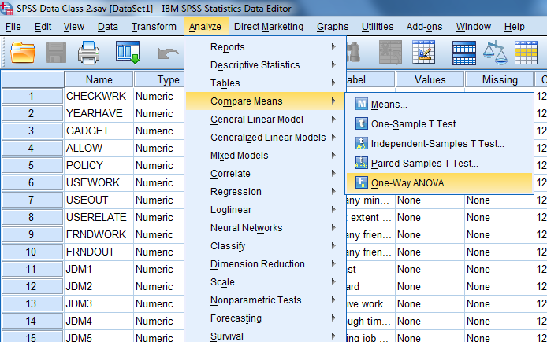
One way analysis of variance (ANOVA)

Slide 63
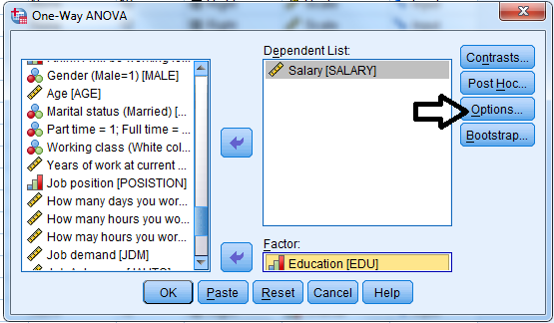
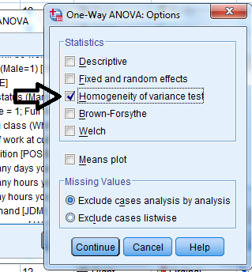
One way analysis of variance (ANOVA)

Slide 64
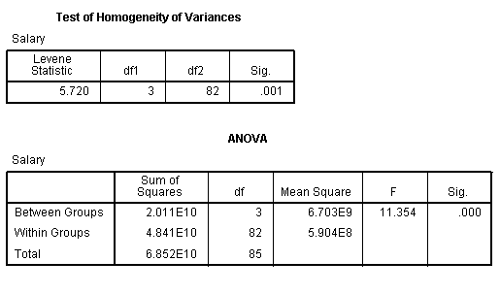
One way analysis of variance (ANOVA)
Significant level of the Levene’s test
If it is < 0.05, equal variances not assumed
If it is > 0.05, equal variances assumed
Significant level of the ANOVA test (F test)
P-value > 0.05: all group have equal mean.
P-value < 0.05: at least one pair of groups have unequal mean.

Slide 65
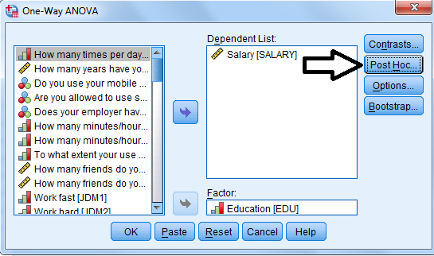
One way analysis of variance (ANOVA)
If you want to see which pair of groups has unequal mean, you need a Post Hoc analysis

Slide 66
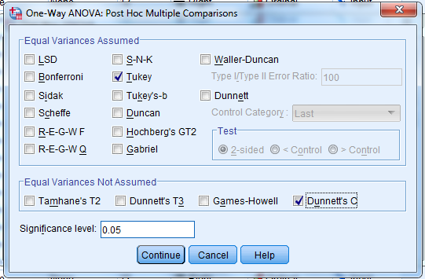
One way analysis of variance (ANOVA)
Use “Turkey” if Equal variances Assumed
Use Dunnett’s C if Equal variances Not Assumed

Slide 67
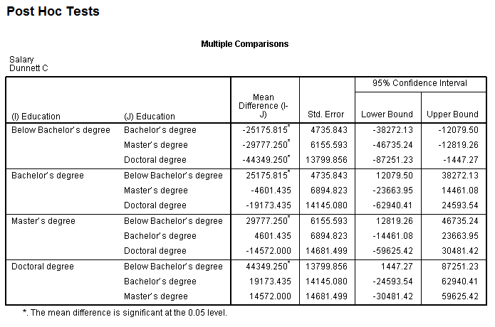
One way analysis of variance (ANOVA)

