Slide 1
Correlation and Regression analysis
Research Methods in Management
Peerayuth Charoensukmongkol, Ph.D.

Slide 2
Example research and hypotheses
Research Topic: Factors that influence student GPA:
How many hours students spend on study per day.
How many times students skip classes.
How many hours student sleep per night.
Hypotheses:
H1: Students who spend more time to study will have higher GPA.
H2: Students who skip less class will have higher GPA.
H3: Students who sleep longer will have higher GPA.

Slide 3
Conceptual framework
Hours spent on study
H1
(+)
H2
(-)
Class
Absence
GPA
H3
(+)
Hours of Sleep

Slide 4
Correlation
Correlation is a statistical technique for estimating the relationships among variables.
For example:
The relationship between Stress and Job performance
The strength of the relationship between two variables is measured by the Correlation coefficient (r).
Correlation coefficient (r) ranges from –1 to +1.

Slide 5
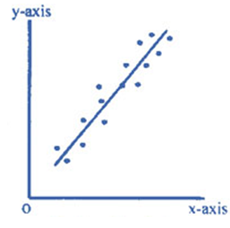
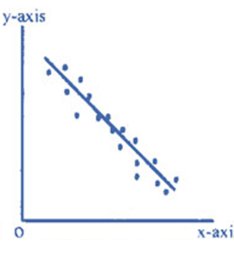
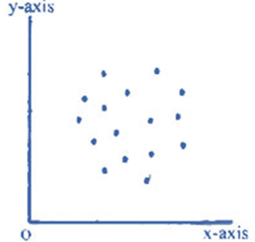
Correlation
Positive correlation
(1 > r > 0)
Negative correlation
(0 > r > -1)
Zero correlation
(r = 0)

Slide 6
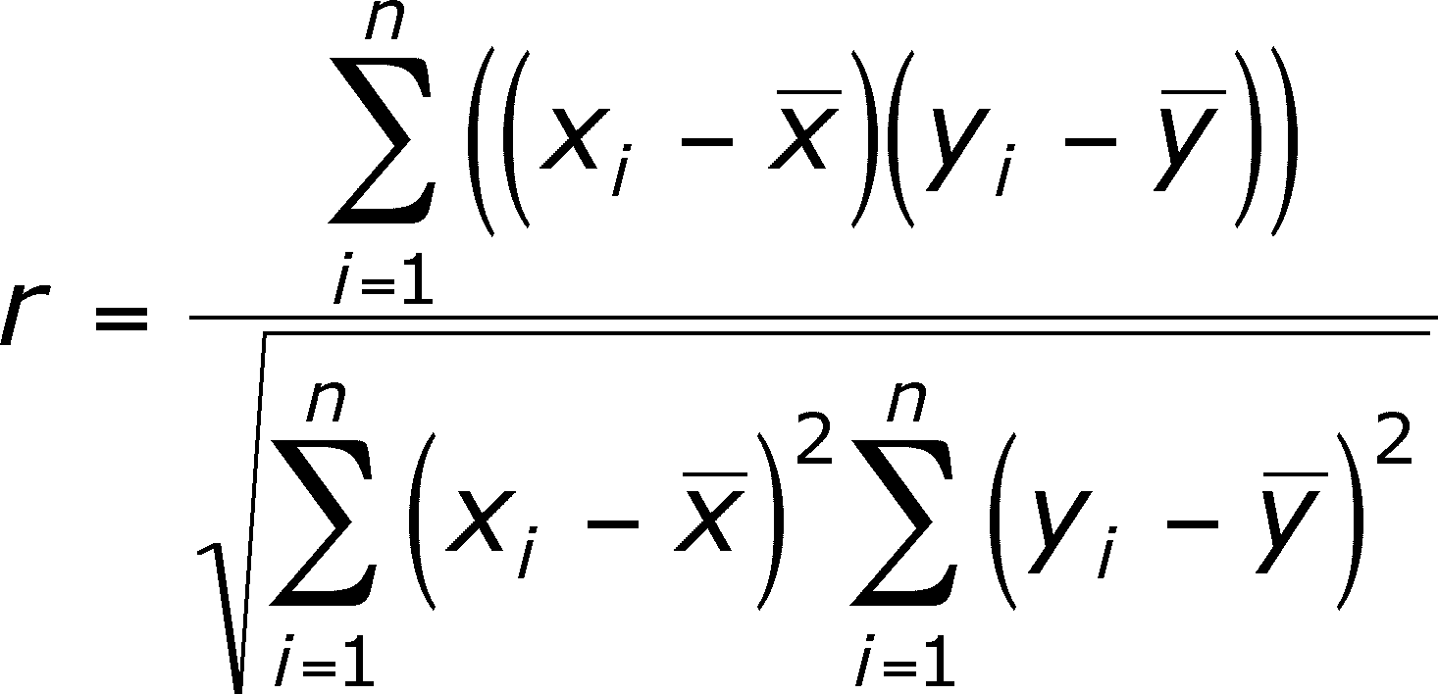
Correlation
X | Y
1 | 3
2 | 4
5 | 6
6 | 7
7 | 9
8 | 8
9 | 3
10 | 4
11 | 9
12 | 14
13 | 15

Slide 7
Correlation
Hypothesis testing of Correlation coefficient (r)
H₀: r = 0 (there is no relationship)
H_{a}: r ≠ 0 (there is some relationship)
(r is greater than or less than 0)
Reject H₀ if p-value < 0.05 (5%)

Slide 8
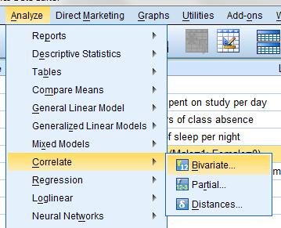
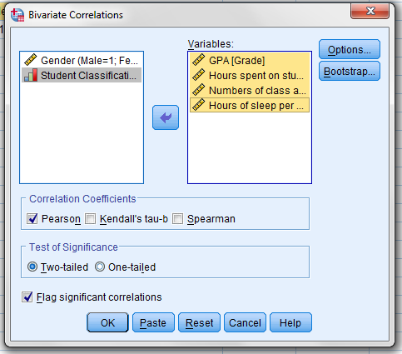
Correlation

Slide 9
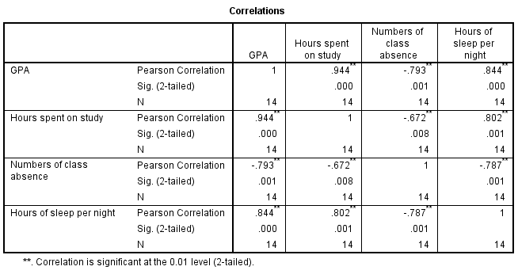
Correlation

Slide 10
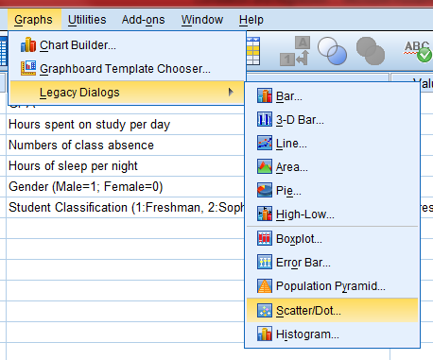
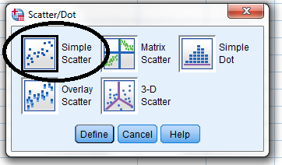
Correlation: Graphical representation

Slide 11
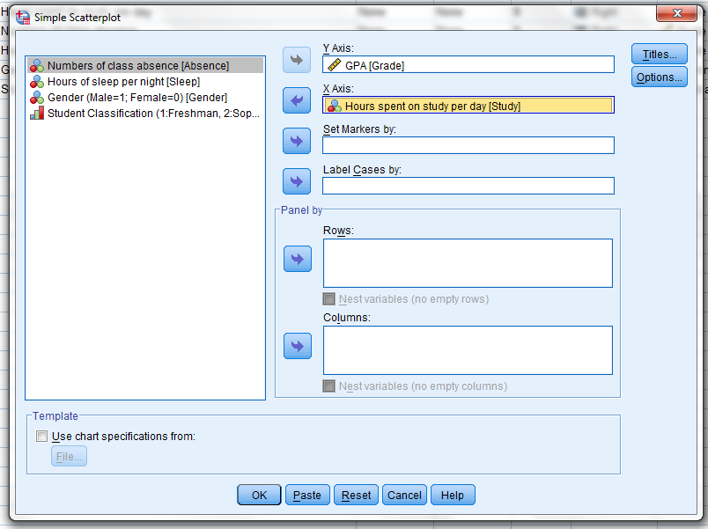
Correlation: Graphical representation

Slide 12
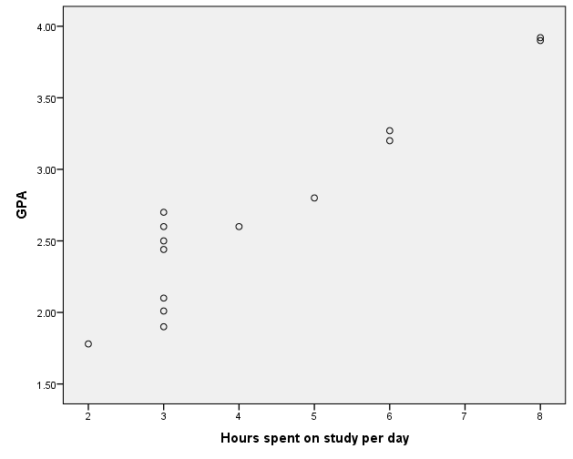
Correlation: Graphical representation

Slide 13
Regression
Regression analysis is a statistical technique for estimating the relationships among variables.
Regression analysis is used for “prediction”.
Regression analysis helps one understand how the typical value of the dependent variable changes when any one of the independent variables is varied, while the other independent variables are held constant.

Slide 14
Regression
Ordinary Least Square (OLS) regression
Weighted Least Square (WLS) regression
Ridge regression
Two-Stage Least Squares (2SLS) regression
Logit regression
Probit regression
Panel Data regression
Partial Least Square (PLS) regression

Slide 15
Simple OLS regression
Y = α + βX ± error
Y = dependent variable
X= independent variable
α = intercept (constant)
β = slope coefficient

Slide 16
Simple OLS regression
Y
10
9
8
7
6
5
4
3
X Number of hours spent on study | Y Test score
1 | 3
2 | 4
5 | 6
6 | 7
7 | 9
8 | 8
Regression line
Error
Error
Error
Slope
Intercept
1 2 3 4 5 6 7 8 X

Slide 17
Simple OLS regression: Intercept
Y = α+ βX
Intercept (α) is the point where the regression line touch the Y axis.
The intercept represents the expected mean value of Y when X is equal to zero
Y
If X=3, Y=4
4
3
2
1
Intercept
If X=2, Y=3.5
If X=0, Y=2
X
0 1 2 3

Slide 18
Simple OLS regression: Slope coefficient
Y = α+ βX
Slope coefficient (β) represents the average change in Y when X change by 1 unit
Example (let’s assume that α = 0)
β = 3:
if X increases 1 unit, Y will increase by 3 units
β = -2:
if X increases 1 unit, Y will decrease by 2 units
β = 0:
No matter how much X changes, Y will not change

Slide 19
Simple OLS regression: Slope coefficient
Y Y Y
X X X
Higher slope
(High β)
One Unit Change in X causes
more unit change in Y
Lower slope
(Low β)
One Unit Change in X causes
less unit change in Y
Zero slope
(β = 0)
No matter
how much X changes,
Y will not change

Slide 20
Calculate α and β
Y = α+ βX
Y: Grade
X: Hours spent on study
Grade = α + β Hours spent on study daily

Slide 21
Calculating α and β
X | Y
1 | 3
2 | 4
5 | 6
6 | 7
7 | 9
8 | 8
9 | 3
10 | 4
11 | 9
12 | 14
13 | 15

Slide 22
Calculate α and β
Hypothesis testing of beta coefficient (β)
H₀: β = 0 (the coefficient is equal to zero)
H_{a}: β ≠ 0 (the coefficient is not equal to zero)
Reject H₀ if p-value < 0.05

Slide 23
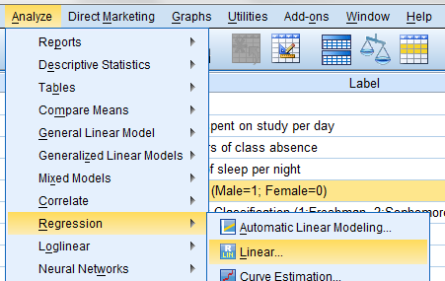
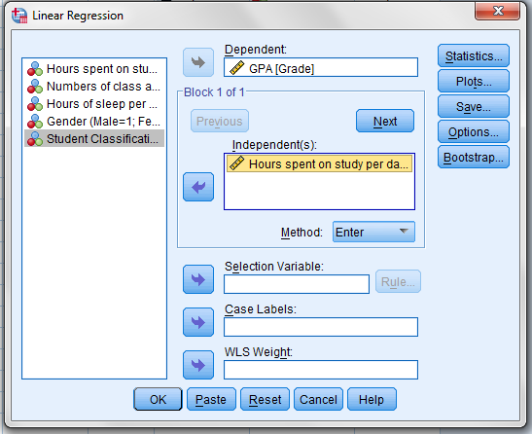
Calculate α and β

Slide 24
Calculating α and β
α
β
P-value
Significant below 0.01
Grade = α + β Hours spent on study daily
Grade = 1.309 + 0.323 Hours spent on study daily

Slide 25
Use simple regression for prediction
Grade = 1.309 + 0.323 Hours spent on study daily
If we didn’t study at all (X = 0), what is the GPA we’ll get?
Grade = 1.309 + (0.323 * 0)
= 1.309
If we studied 2 hours daily (X = 2), what is the GPA we’ll get?
Grade = 1.309 + (0.323 * 2)
= 1.309 + 0.646
= 1.955

Slide 26
Use simple regression for prediction
Y = α+ βX
Y: Grade
X: Class absence
Grade = α + β Class absence
From the regression analysis in SPSS:
α (constant) = 3.417
β = -0.533; p-value = 0.001 (significant at below 1%)
Grade = 3.417 – 0.533 Class absence

Slide 27
Use simple regression for prediction
Grade = 3.417 – 0.533 Class absence
If we didn’t skip class (X = 0), what is the GPA we’ll get?
Grade = 3.417 – (0.533 * 0)
= 3.417
If we skip 2 classes (X = 2), what is the GPA we’ll get?
Grade = 3.417 – (0.533 * 2)
= 3.417 – 1.066
= 2.351

Slide 28
Use simple regression for prediction
Y = α+ βX
Y: Grade
X: Hours of sleep nightly
Grade = α + β Hours of sleep nightly
From the regression analysis in SPSS:
α (constant) = -1.238
β = 0.626; p-value < 0.001 (significant at below 0.1%)
Grade = -1.238 + 0.626 Hours of sleep nightly

Slide 29
Use simple regression for prediction
Grade = -1.238 + 0.626 Hours of sleep nightly
If we didn’t sleep at all (X = 0), what is the GPA we’ll get?
Grade = -1.238 + (0.626 * 0)
= -1.238
If we slept 8 hours nightly (X=8), what is the GPA we’ll get?
Grade = -1.238 + (0.533 * 8)
= -1.238 + 4.264
= 3.026

Slide 30
Use simple regression for prediction
Y = α+ βX ± error
A regression line will always contain error terms (ε).
In reality, independent variables are never perfect predictors of the dependent variables; there are always many uncontrollable factors.
The error term exists because a regression model can never include all possible variables; some predictive capacity will always be absent, particularly in simple regression.

Slide 31
Use simple regression for prediction
Y = α+ βX ± error
Y: Grade
X: Hours of sleep nightly
Error: other factors that might affect test score, but are not included in the equation
Y = -1.238 + 0.626X ± 0.37782

Slide 32
Use simple regression for prediction
Coefficient of determination (R² or R squared) indicates how well data points fit a line or curve.
High R squared
Low R squared

Slide 33
Use simple regression for prediction
R squared represents the proportion of total variation of outcomes explained by the independent variable(s) in the model.
R squared ranges from 0 to 1:
An R squared of 1 indicates that the regression line perfectly fits the data
The higher the R squared, the lower the regression error

Slide 34
Use simple regression for prediction
R square = 0.713 means that the regression model can explain about 71.3% of student grade
Adjusted R squared is a modification of R squared that adjusts for the number of explanatory terms in a model. Unlike R squared , the adjusted R squared increases only if the new term improves the model more than would be expected by chance.

Slide 35
Multiple OLS regression
The general purpose of multiple regression is to learn more about the relationship between “several independent variables” and a dependent or criterion variable
Simple regression: Y = α+ βX + error
Multiple regression
Y = α+ β₁X1 + β₂X2 + β₃X3 + error

Slide 36
Multiple OLS regression
Y = α+ β₁X1 + β₂X2 + β₃X3 + error
Y: Grade
X1: Hours spent on study
X2: Number of class absence
X3: Hours of sleep nightly
Grade = α + β₁ Hours spent on study
+ β₂ Number of class absence
+ β₃ Hours of sleep nightly
+ error

Slide 37
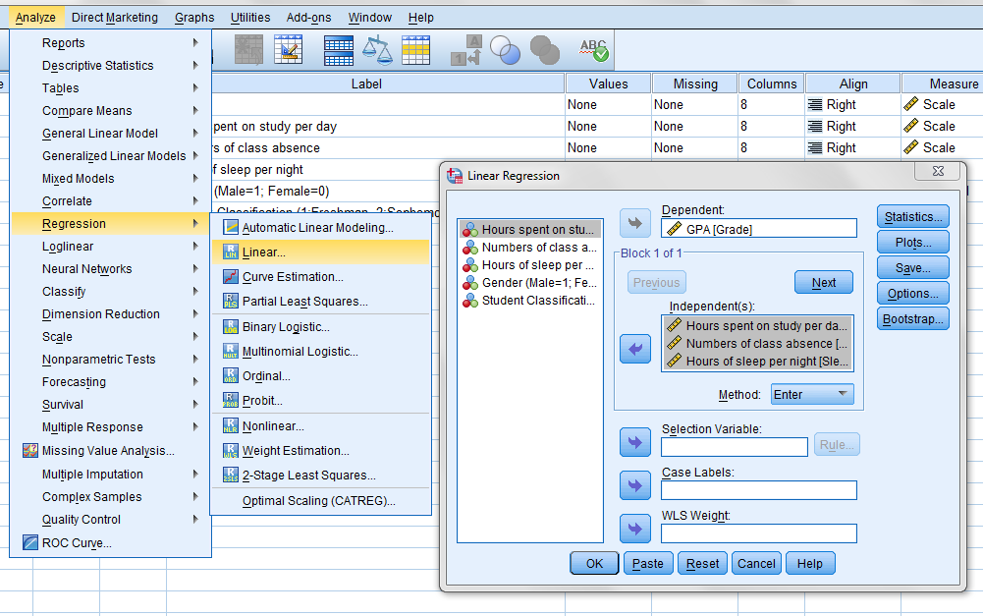
Multiple OLS regression

Slide 38
Multiple OLS regression
Significant at below 0.1%
Statistically insignificant

Slide 39
Example research and hypotheses
H1: Students who spend more time to study will have higher GPA
The relationship is positive and statistically significant (β=0.246; p<0.001). Thus, this hypothesis is supported
H2: Students who skip less class will have higher GPA
Although the relationship is negative, it is not statistically significant (β=-0.176; p=0.07). Thus, this hypothesis cannot be supported
H3: Students who sleep longer will have higher GPA
Although the relationship is positive, it is not statistically significant (β=0.046; p=0.706). Thus, this hypothesis cannot be supported
Conclusion: Students should spend more time to study to get higher GPA

Slide 40
Multiple OLS regression: R squared
All 3 factors (Hours spent on study daily, Number of class absence, and Hours of sleep nightly) can explain 93.7% of student GPA.
There are still 6.3% that should be explained by other factors, beyond these 3 factors

Slide 41
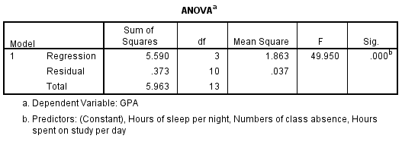
Multiple regression: F Statistics
The "F value'' statistics test the overall significance of the regression model. It test the null hypothesis that all of the regression coefficients are equal to zero.
H₀: All of the regression coefficients (β) = 0
H_{a}: At least some regression coefficients (β) ≠ 0
Reject H₀
at below 0.001

Slide 42
Categorical variable: Dummy variable
A dummy variable is a “nominal-scale” variable that takes the value “0” or “1” to indicate the absence or presence of some categorical effect that may be expected to shift the outcome.
Examples:
Gender (Male = 1; Female = 0)
Marital status (Married = 1; Single = 0)
Do you work (Yes = 1; No = 0)
The category that takes the value “1” will be use as a benchmark for comparison.

Slide 43
Categorical variable: Dummy variable
Y = α+ β₁X1 + β₂X2 + β₃X3+ β₄X4
Y: Grade
X1: Hours spent on study
X2: Number of class absence
X3: Hours of sleep nightly
X4: Gender (Male = 1; Female = 0)
In this case, since Male = 1, it will be used as a benchmark

Slide 44
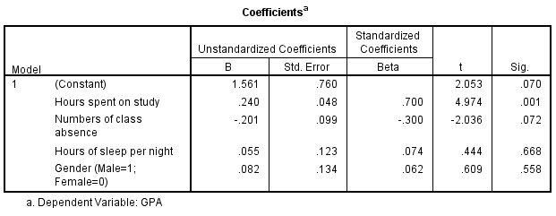
Categorical variable: Dummy variable
A positive β =0.082 suggests that Male tends to have higher GPA than Female
(Male is used as a benchmark since its value was set to “1”
However, this GPA difference is not statistically significant
(p value > 0.05)

Slide 45
Categorical variable: Ranked variable
A Ranked variable, also called “ordinal-scale” variable, is a variable for which the individual observations can be put in order from smallest to largest
Example:
Student classification
1: Freshman
2: Sophomore
3: Junior
4: Senior

Slide 46
Categorical variable: Ranked variable
Y = α+ β₁X1 + β₂X2 + β₃X3+ β₄X4 + β₅X5
Y: Grade
X1: Hours spent on study
X2: Number of class absence
X3: Hours of sleep nightly
X4: Gender (Male = 1; Female = 0)
X5: Student classification
(1: Freshman, 2: Sophomore, 3: Junior, 4: Senior)

Slide 47
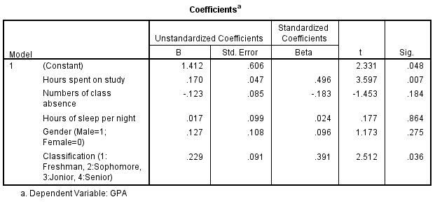
Categorical variable: Ranked variable
A positive β =0.229 suggests that students with higher classification tends to have higher GPA than those with lower classification
This GPA difference is also statistically significant
(p value < 0.05)

Slide 48
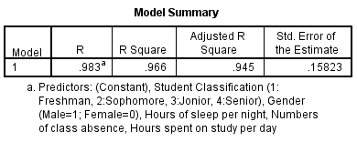
Multiple OLS regression: R squared
All 5 factors (Hours spent on study daily, Number of class absence, and Hours of sleep nightly, Gender, Student classification) can explain 96.6% of student GPA.
There are still 3.4% that should be explained by other factors, beyond these 5 factors

Slide 49
Report regression results
Beta Coefficient (β)
Level of significance
Use * to indicate if p-value < 0.05 (5%)
** to indicate if p-value < 0.01 (1%)
*** to indicate if p-value < 0.001 (0.1%)
R squared, Adjusted R square

Slide 50
Report regression results
Hours spent on study
Gender
(Male=1)
H1
0.17**
0.127
H2
-0.123
Class
Absence
GPA
H3
0.017
0.229*
R² = 0.966
Adj. R² = 0.945
Student
Classification
Hours of Sleep
Main
independent variables
Control
variables

Slide 51
Report regression results
Variables | Coefficients
Constant | 1.412*
Main independent variables
Hours spent on study | 0.17**
Class Absence | -0.123
Hours of Sleep | 0.017
Control variables
Gender (Male=1) | 0.127
Student classification | 0.229*
R square | 0.966
Adjusted R square | 0.945
Note: ** p<0.01; * p<0.05

Slide 52
Some assumptions for unbiased estimation
Model is correctly specified
Data is normally distributed
No serious endogeneity issue
No serious heteroscedasticity issue
No serious multicollinearity issue
No serious autocorrelation issue

Slide 53
Multicollinearity
Multicollinearity is a statistical phenomenon in which two or more predictor variables in a multiple regression model are highly correlated
Y = α+ β₁X1 + β₂X2 + β₃X3
X1, X2, and X3 must not correlate strongly with one another
In this situation, the coefficient estimates (β) may change erratically in response to small changes in the model or the data.

Slide 54
Multicollinearity
In multiple regression, the variance inflation factor (VIF) is used as an indicator of Multicollinearity.
A value of 10 was recommended as the maximum level of VIF, as suggested by Hair et al (1995).
Reference
Hair, J. F. Jr., Anderson, R. E., Tatham, R. L. & Black, W. C. (1995). Multivariate Data Analysis (3rd ed). New York, NY: Macmillan.

Slide 55
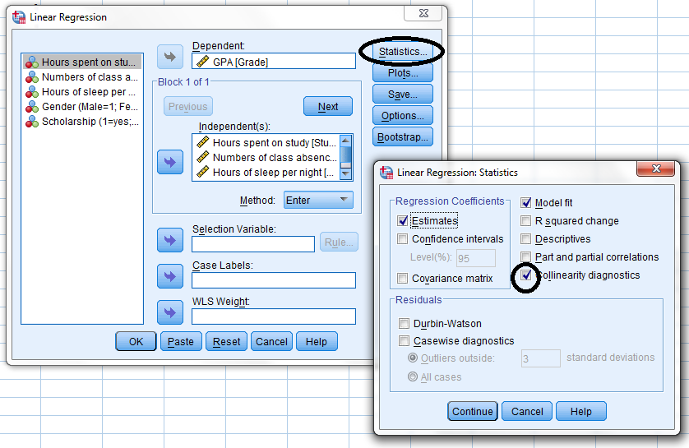
Multicollinearity

Slide 56
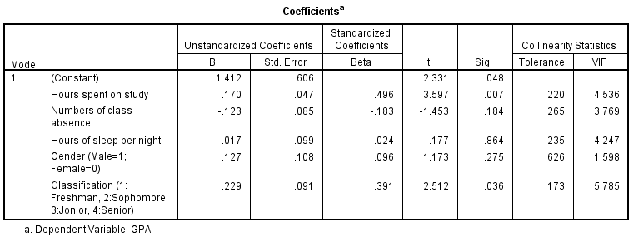
Multicollinearity
Every value must be lower than 10

Slide 57
Dummy variable regression
Nominal scale more than 2 categories
For example: Colleges & Majors
School of Business
School of Arts
School of Engineering
Select one category as a benchmark.
This category will be omitted from the regression.
This category will be use for comparison with other categories that are included in the regression.
Yes=1
No=0

Slide 58
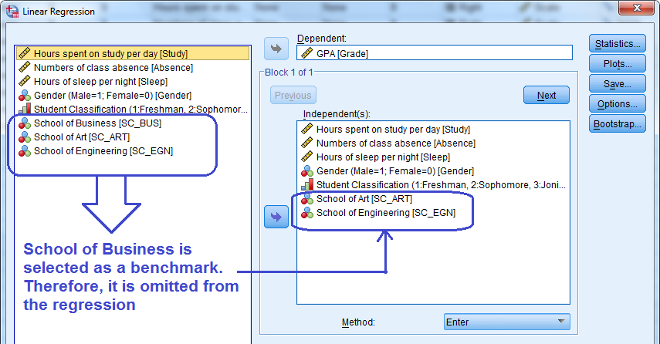
Dummy variable regression

Slide 59
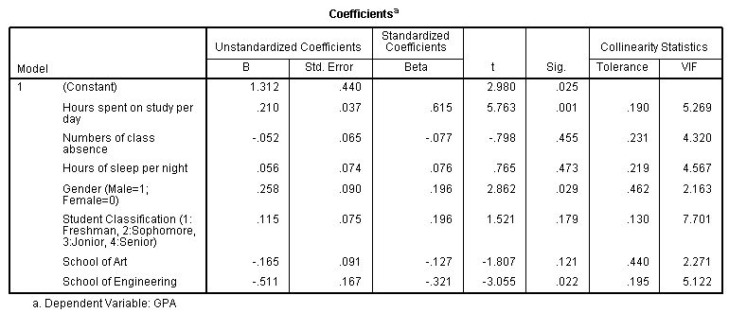
Dummy variable regression
Beta of the constant is used as a representative of the GPA of the category that is omitted (School of business)
Betas of other category are compared
with the beta of the constant to estimate the difference from the omitted category
P-value is used to justified whether the difference is statistically supported or not (support if p<0.05)

Slide 60
Dummy variable regression
Highest GPA
Beta of Constant = X
The GPA of students who are in school of business = 1.312
Beta of school of art = -0.165 (p-value=0.121)
Negative beta means the GPA of students who are in school of art is lower than student who are in school of business
The GPA of students who are in school of art:
= X – 0.165
But because the p-value is higher than 0.05, this result cannot be supported.
Beta of school of engineering = -0.511 (p-value=0.022)
Negative beta means the GPA of students who are in school of engineering is lower than student who are in school of business
The GPA of students who are in school of engineering:
= X – 0.511
Because the p-value is lower than 0.05, this result is statistically supported.
2nd Highest GPA
Lowest GPA

Slide 61
Unstandardized VS Standardized Beta coefficient
Unstandardized Beta coefficient
Rate of change (β) of each variable is interpreted in “actual” unit.
E.g., β of Hours spent on study per day = .21 If study time increases by 1 hour, GPA will increase by .21

Slide 62
Unstandardized VS Standardized Beta coefficient
Standardized Beta coefficient
Rate of change (β) of all variables are converted into the same unit.
Rate of change is interpreted using “standard deviation” unit
Standardized coefficients refer to how many standard deviations a dependent variable will change, per standard deviation increase in the independent variable
Standardization of the coefficient is usually done to answer the question of which of the independent variables have a greater effect on the dependent variable in a multiple regression analysis, when the variables are measured in different units of measurement
The coefficients ignore the independent variable's scale of units, which makes comparisons easy

Slide 63
Unstandardized VS Standardized Beta coefficient
Standardized Beta coefficient
Rate of change (β) of each variable is interpreted using “standard deviation” unit E.g., Standardized β of Hours spent on study per day = .615 If study time increases by 1 standard deviation, GPA will increase by .615 standard deviations

Slide 64
Research case practice
Having happy employees is one of the main policies of the organization. Thus, the HR manager hired you to conduct a research to investigate what are major factors that influence employee job satisfaction. After interviewing with some key people in the organization, you believed that there might be 4 factors that employees concern. These factors includes:
(1) Job demands; (2) Job autonomy; (3) Coworker support; and (4) Supervisor support
In addition to these 4 main factors, there are some demographic and job-related factors might affect job satisfaction of employee as well. So, you need to control for these factors, including:
(1) Age; (2) Gender; (3) Job position (4) Departments

Slide 65
Research case practice
After you collected the data from the employee sample, it’s time to conduct the regression analysis to determine what are important factors that the company should focus in order to enhance employee satisfaction.
(Note: Use standardized beta coefficients to interpret the results)
Among the 4 factors (Job demands, Job autonomy, Coworker support, Supervisor support), which one are the strong predictors of job satisfaction?
Interpret the effects of all control variables.
Overall, how many percent that “all variable” in the regression model can explain job satisfaction?
Use regression results to provide the policy recommendation for the company to help them increase employee job satisfaction.

Slide 66
Conceptual model
Gender
(Male=1)
Job demands
Age
Job autonomy
Job position
Job satisfaction
Coworker support
Department: Sales
Supervisor support
Department: Accounting
Main independent variables
Control variables

Slide 67
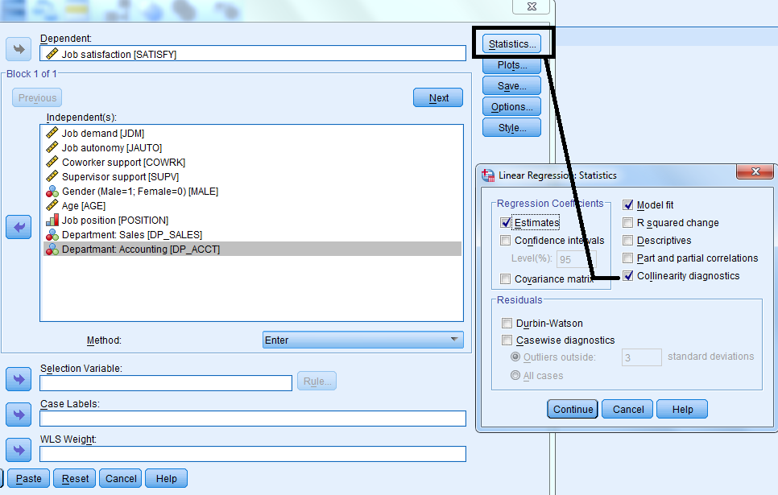

Slide 68
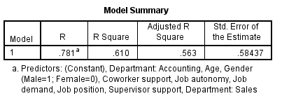
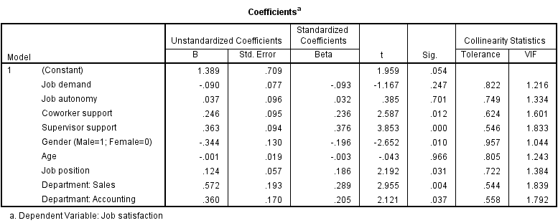
x
Use standardized coefficients to compare the effects of the variables measured using different types of scale

Slide 69
Results
Coworker support positively and significantly associates with job satisfaction (β=0.236; p=0.012).
As coworker support increases by 1 standard deviation, job satisfaction will increase by 0.231 standard deviation
Supervisor support positively and significant associates with job satisfaction (β=0.376; p<0.001).
As supervisor support increases by 1 standard deviation, job satisfaction will increase by 0.376 standard deviation
By comparing the standardized coefficients, we can conclude that supervisor support has the strongest effect on job satisfaction, following by coworker support.

Slide 70
Results
Job demands negatively associates with job satisfaction (β=-0.093; p=0.247). Not statistically supported
As job demands increases by 1 standard deviation, job satisfaction will decrease by 0.093 standard deviation.
Job autonomy positively associates with job satisfaction (β=0.032; p=0.701). Not statistically supported
As job autonomy increases by 1 standard deviation, job satisfaction will increase by 0.701 standard deviation.
Because the p-values of these two variables are higher than 0.05, the conclusion is that job demands and job autonomy do not significantly relate to job satisfaction.

Slide 71
Results
Male employees has lower job satisfaction than female employees (β=-0.196; p=0.01). Statistically supported
Older employees have lower job satisfaction than younger employees (β=-0.003; p=0.966). Not statistically supported
Employees with higher job position have more job satisfaction than employees with lower job position (β=0.186; p=0.031). Statistically supported

Slide 72
Results
Compare job satisfaction among employees in 3 departments
Because a dummy variable of HR department is omitted from the regression, this group will be used as a benchmark for comparison:
β of a dummy variable of Sales department employees = .289 (positive)
Their level of job satisfaction is higher than HR employees by .289
(p-value=.004) Statistically supported
β of a dummy variable of Accounting department employees = .205 (positive)
Their level of job satisfaction is higher than HR employees by .205
(p-value=.037) Statistically supported
Conclusion: Department matters.
Employee in sale department has the highest level of job satisfaction, following by accounting department, and HR department. There findings are also statistically supported.

